Slide 1
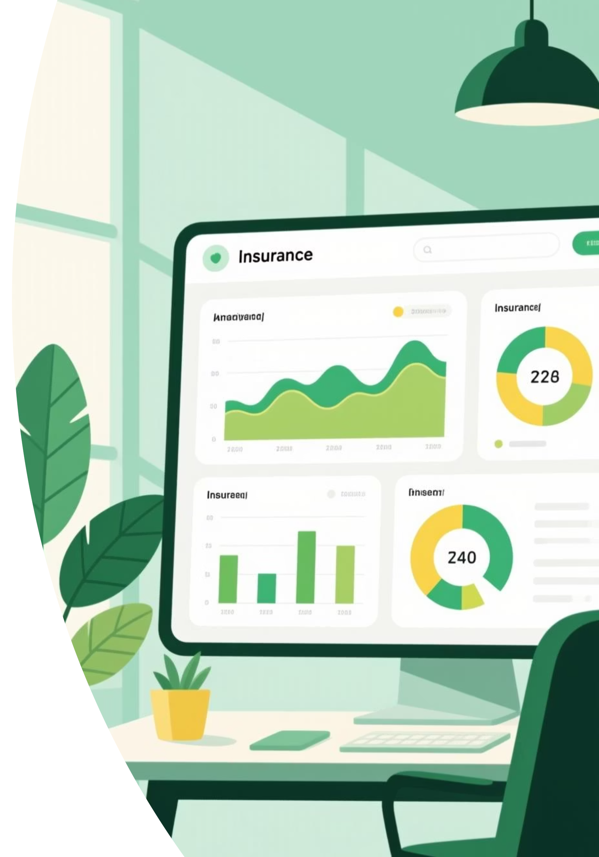
Insurance Claim Analysis
Uncovering insights from 37,542 policies to guide strategic business decisions

Slide 2
Project Overview
Our Mission
37.5K
Analyzing customer insurance claims using transactional data from 37,542 policies across various coverage zones.
Total Policies
We're uncovering insights into claim patterns, customer segments, and claim frequencies to drive strategic business decisions.
Analyzed across all zones
16
Key Features
Data points examined

Slide 3
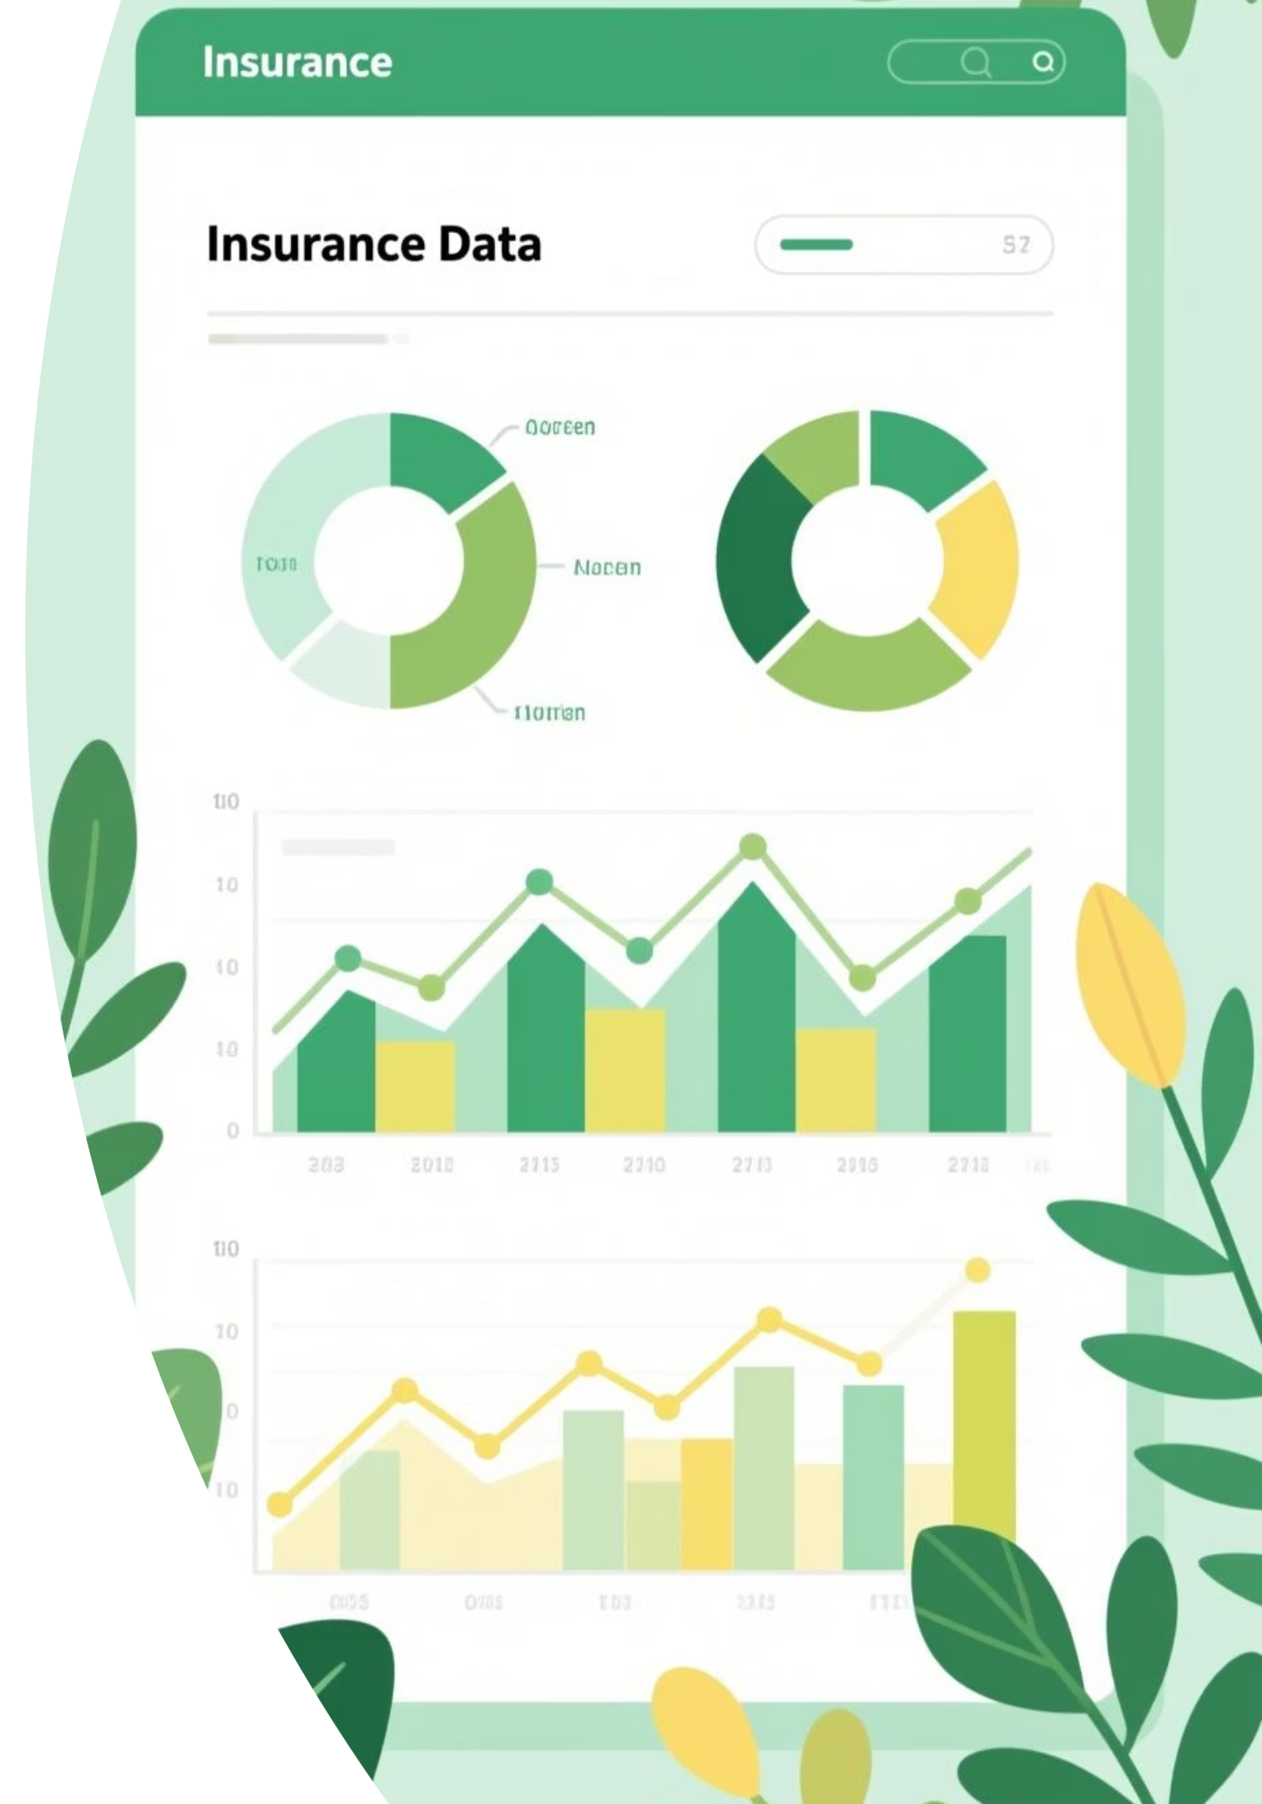

Dataset Deep Dive
Customer Demographics
Age distribution
Gender breakdown
Marital status
Number of kids
Coverage zone
Claim Details
Claim amounts
Claim frequency
Kids driving status
Vehicle information

Slide 4
Key Data Dimensions
01
02
03
37,542 Rows
16 Columns
Multiple Zones
Individual policy records analyzed for comprehensive insights
Critical data points spanning demographics and claims
Coverage areas from rural to highly urban environments

Slide 5
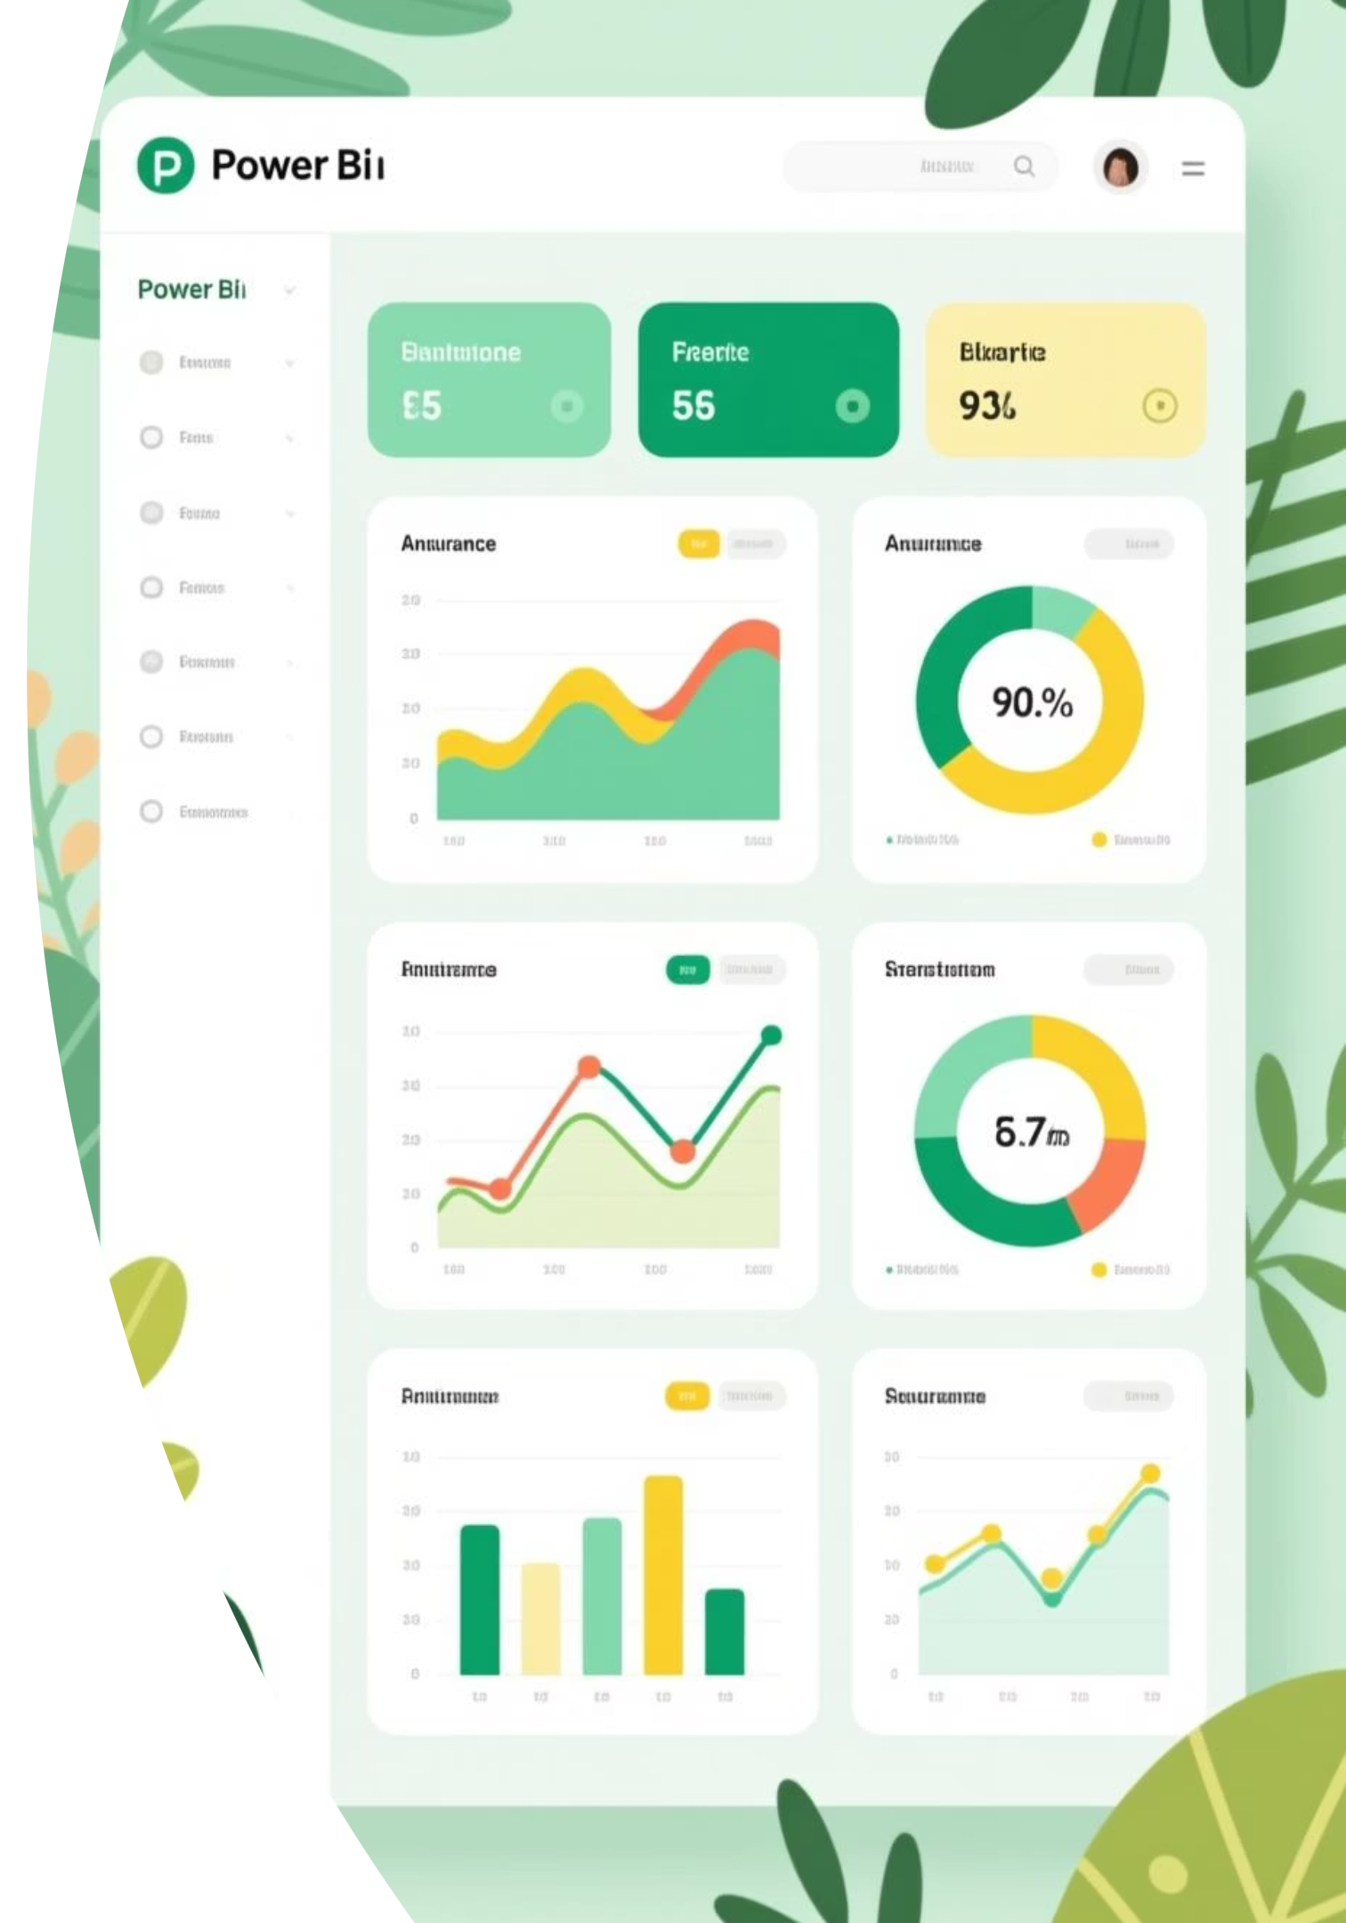
Power BI Dashboard
Interactive visualization bringing insights to life
Our comprehensive dashboard presents claim patterns, customer segments, and risk factors through intuitive visual analytics.

Slide 6

Business Recommendations
Five strategic initiatives to optimize profitability and reduce risk

Slide 7
Premium & Marketing Strategy
1
2
Segment-Based Premium Adjustment
Targeted Marketing Campaigns
Increase premiums for age groups 46–65 and private-use vehicles (high-claim segments). Offer loyalty discounts for low-risk groups like families with kids driving.
Focus marketing on bachelors and high school graduates — core customer base with high claim value but likely to renew policies.

Slide 8
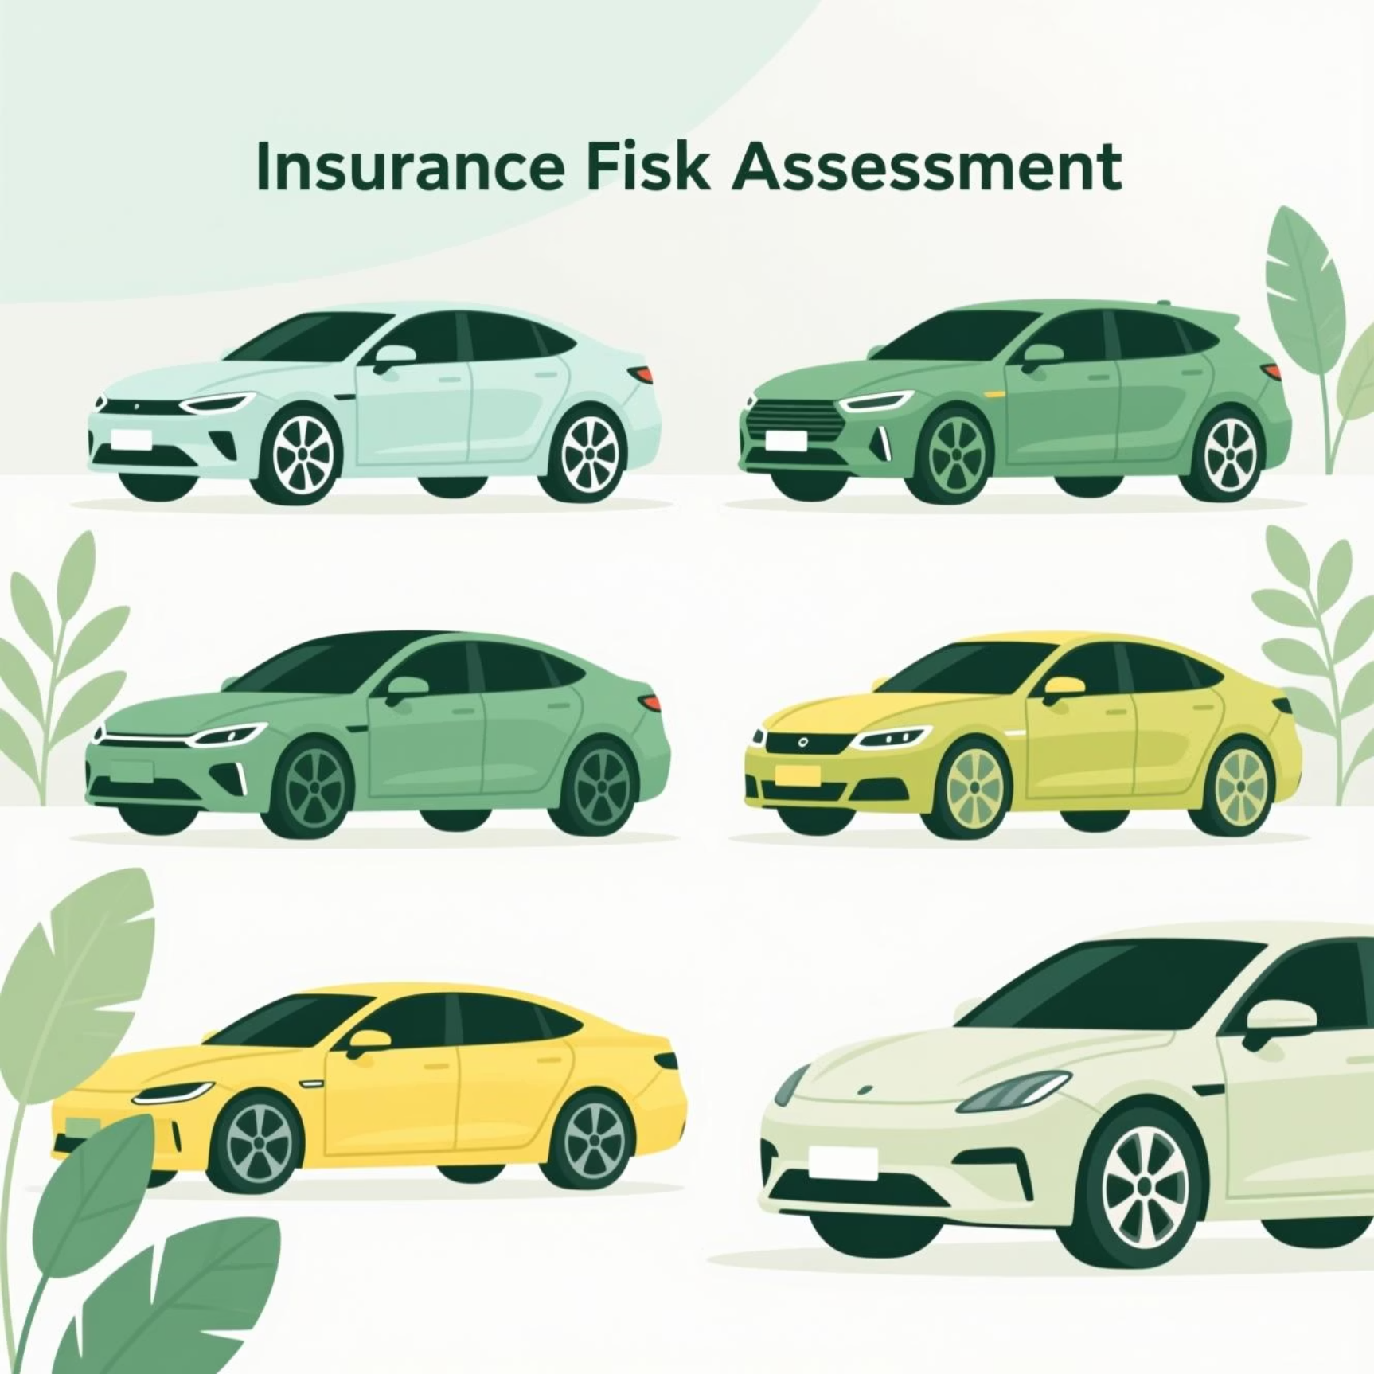

Vehicle & Zone Risk Management
Vehicle-Specific Risk Pricing
Urban Safety Incentives
Introduce car-make-based premium tiers with higher premiums for high-claim makes like Ford and Chevrolet.
Launch accident prevention and safe-driving rewards programs in urban and highly urban zones.

Slide 9





Fraud Prevention Strategy
Monitor Frequency
Set Thresholds
Average claim frequency: 0.5 per policy
Flag policyholders exceeding normal rates
Prevent Fraud
Key Insight: Enhanced claim frequency monitoring can significantly reduce fraudulent activities and protect company resources.
Proactive detection of suspicious activities

Slide 10
Next Steps
Launch Marketing Campaigns
Implement Premium Adjustments
Target core customer segments with tailored messaging
Roll out segment-based pricing across high-risk categories
Measure & Optimize
Deploy Monitoring Systems
Track results and refine strategies for continuous improvement
Activate fraud detection and claim frequency tracking

